Slide 1

The Next-Gen Crowdfunding Dapp using Blockchain (PSID-1589)
1. Patil Manasi Ramkrushna (TYAIML-19)
2. Bari Vaibhav Ramchandra (TYAIML-43)
3. Patil Sakshi Rajendra (TYAIML-58)
4.Mali Nitisha Sharad(TYAIML-59)
Department of Articial Intelligence and Machine Learning
The Shirpur Education Society’s
R. C. Patel Institute of Technology, Shirpur - 425405.
[2024-25]

Slide 2
Problem Statement :
In today’s digital landscape, fraudulent campaigns, misinformation, and lack of transparency are major concerns in crowdfunding and decentralized governance systems. Traditional platforms struggle with authenticity verification, campaign classification, and user sentiment analysis, making them vulnerable to scams and manipulation.

Slide 3
Introduction
A practical problem statement emerges: How can organizations effectively transition from centralized crowdfunding platforms to de centralized blockchain solutions, ensuring transparency, security, and efficiency, while overcoming implementation hurdles and regulatory obstacles
Smart contracts enhance security, mitigating fraud risks, while bypassing intermediaries streamlines processes, reducing transaction costs and delays. Yet, transitioning to blockchain-powered crowdfunding presents challenges, such as integration complexities and regulatory uncertainties, hindering widespread adoption.

Slide 4
Existing System Survey
Current Crowdfunding Platforms-
Traditional Platforms: Kickstarter, GoFundMe, Indiegogo
Blockchain-based Platforms: Gitcoin, Polkadot, Fundition, CoinStarter
Key Difference: Blockchain provides decentralization, transparency, and lower fees.
Blockchain Integration:
Smart Contracts: Trustless automation of transactions.
Tokenization: Use of utility tokens and NFTs for funding.
Blockchain Networks: Ethereum, Polkadot, Binance Smart Chain.

Slide 5
Objective
Leverage Blockchain for Transparency & Security
Ensure secure and immutable transaction records in crowdfunding.
Eliminate Centralized Authority
Enable decentralized tracking of fund usage and governance decisions.
Automate secure and efficient fund allocation, reducing risks of fraud.
Maintain tamper-proof financial records and improve trust in fund distribution.

Slide 6
Flowchart:
Fundraising & Donor Contributions
User Registration & Authentication:
Transparency & Project Updates
01
02
03
04
05
Campaign Creation & Smart Contract Deployment:
Fundraiser submits campaign details (project name,goal amount, deadline).
Fund Distribution and Verification

Slide 7
Technology Stack
Blockchain Infrastructure
Blockchain Network: Ethereum (Can also support Polygon, Solana, or Binance Smart Chain)
Blockchain Interaction:
Web3.js / Ethers.js (Frontend)
Web3.py (Backend)
Decentralized Storage:
IPFS (InterPlanetary File System) for storing project documents & proofs.

Slide 8
Backend :
Backend & API Development
Framework: Flask / FastAPI (Python) for API development.
Functionality:
Accepts user requests (fundraisers, donors, investors).
Interacts with the smart contract.
Manages transactions and campaign status.

Slide 9
Frontend :
Frontend & User Interface
Technology: React.js / Next.js (for a dynamic DApp UI).
Wallet Integration: MetaMask, WalletConnect for Ethereum authentication.
User Features:
Project submission (by fundraiser).
Fund donation (by backers).
Real-time tracking of funding progress on blockchain.

Slide 10
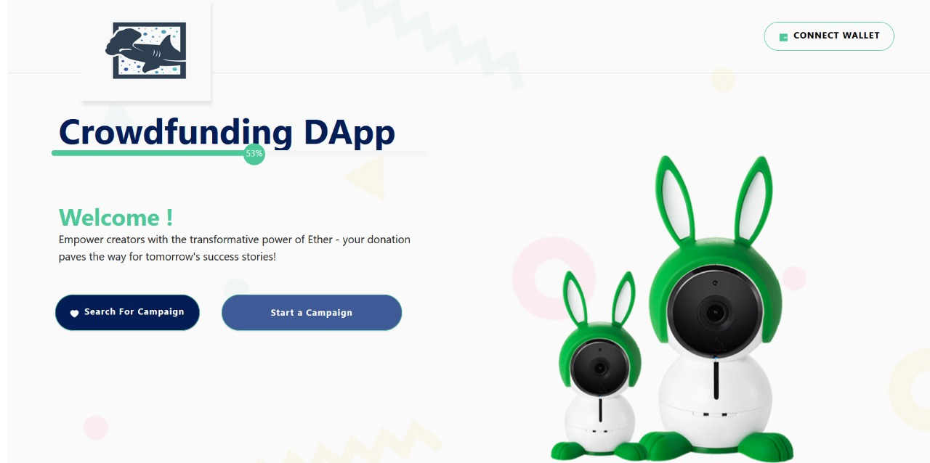
Implementation

Slide 11
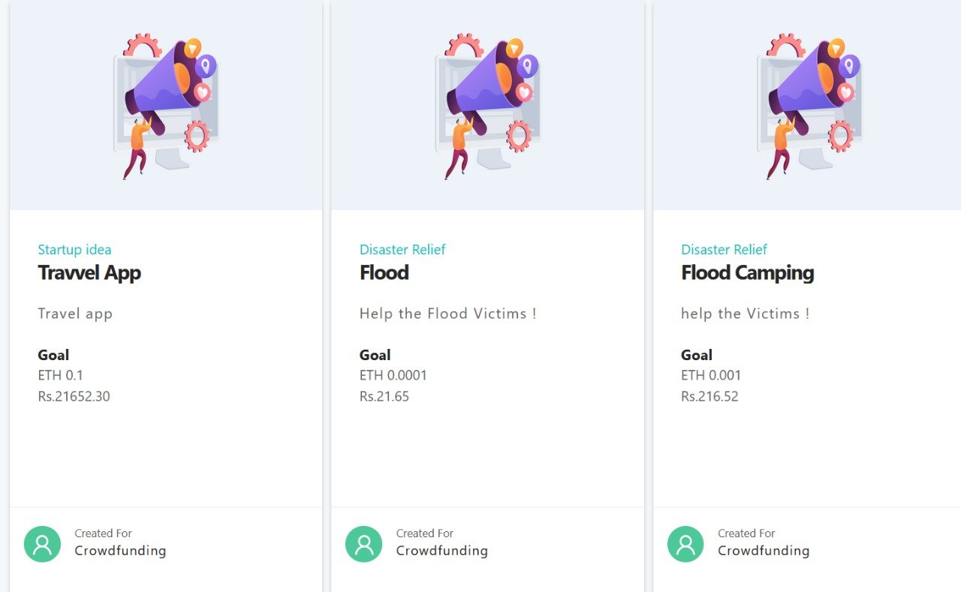

Slide 12
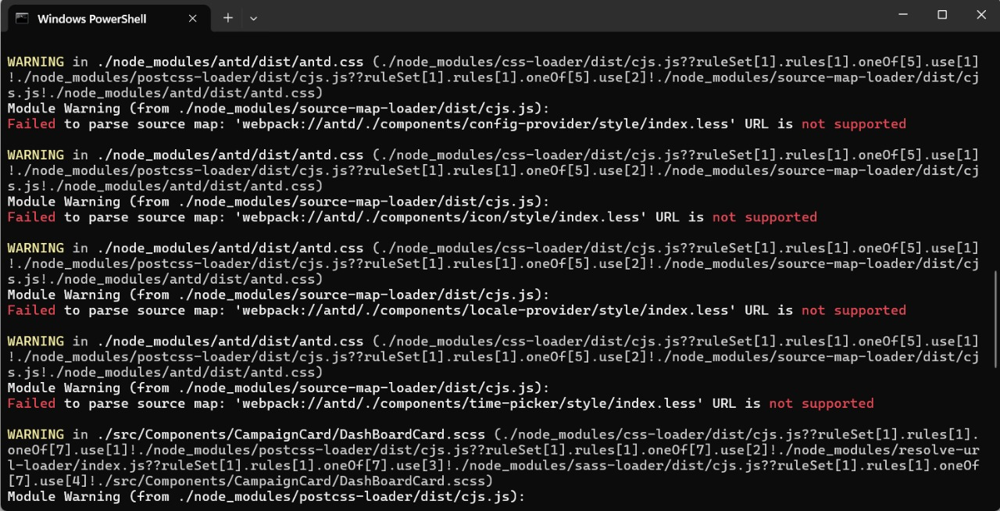

Slide 13
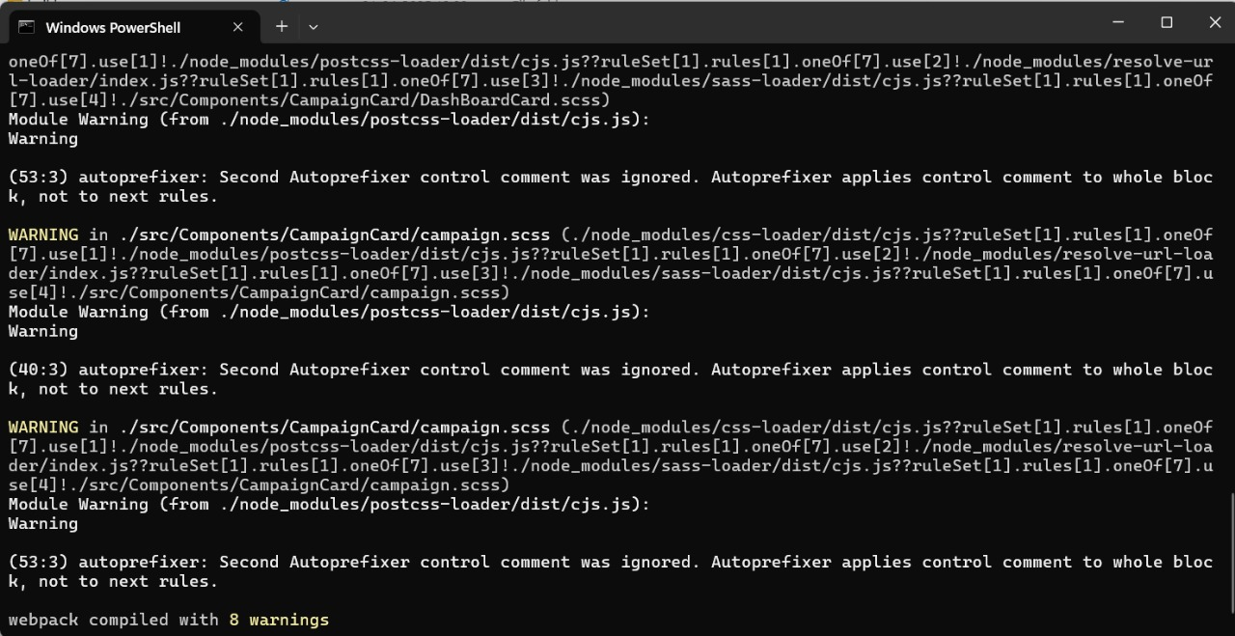

Slide 14
Error Overview
Issue: The 'Connect Wallet' button is not responding when clicked.
Expected Behavior: It should prompt the user to connect their MetaMask or another wallet.
Actual Behavior: No response or error in the console.

Slide 15
Goal of Project :
A decentralized crowdfunding removes trust barriers, lowers costs, and ensures fair fund distribution. The blockchain-powered model enhances transparency and security, solving key issues in traditional crowdfunding.
The goal of this project is to design and implement a blockchain-based crowdfunding system that eliminates intermediaries, enhances trust, and ensures secure and verifiable transactions.

Slide 16
Conclusion
The first phase establishes a functional frontend with React.js/Next.js, wallet integration, and real-time campaign tracking, laying the foundation for a decentralized crowdfunding system. While showcasing the platform’s potential, the next step is backend development and smart contract integration to ensure security, transparency, and automation, driving the transition to a fully decentralized solution.

